Slide 1
Using Graphs, Tables, Charts, and illustrations in Technical Reports
Effective Visuals
FOUZIA GOREJA
ASSISTANT PROFESSOR

Slide 2
VISUALS
Capture and hold people’s attention
Help illustrate textual information and data
Simplify complicated textual descriptions
Help the reader understand complicated systems, processes, data, and mechanisms.

Slide 3
TYPES OF VISUALS
Visuals are referred to as either TABLES or FIGURES.
TABLES contain detailed data/information formatted in rows and columns for visual comparison.
FIGURES can take many forms and include
Graphs
Charts
Illustrations

Slide 4
When to use..
Tables show the most amount of detail but require study. Use a table when detail is needed; refer to the details in the text, and if necessary, move the table to an appendix.
Figures such as graphs and charts illustrate trends or contrast more dramatically but lose the detail. Make the point with the graph, but back it up in the text.

Slide 5
Principles of Effective Visuals
Simple Design: make visuals clear, easy to understand; don’t over-complicate them.
Not“decoration”: visuals perform a useful function, they don’t just decorate your document
Clarification: visuals illustrate and supplement written ideas; they do not “replace” textual information

Slide 6
5 RULES for including visuals:
Number and caption every visual sequentially
Tables and Figures are numbered separately
Captions should be brief, accurate, and informative/descriptive
Discuss each visual in the body text, referring to the caption number.
Never omit, distort, or manipulate information to deceive or mislead
Cite the sources of visuals you did not create yourself
Clearly label all elements of a visual (legends, axes, scale, direction, etc.) and provide a “key”

Slide 7
Additional Considerations
Place the visual as soon as possible after the in-text reference to that visual (on the same page if at all possible)
Table captions must be placed ABOVE the table; figure captions can be placed above or below (but be consistent)
Point of view should match that of the reader performing illustrated procedure
Present all visuals in an appealing manner
Don’t crowd them by the text or squeeze in between other visuals
Use white space to enhance readability
Avoid spelling mistakes, poor grammar, inconsistent formatting, in labels, key, title or accompanying text
Use computer applications critically; simple is good.

Slide 8
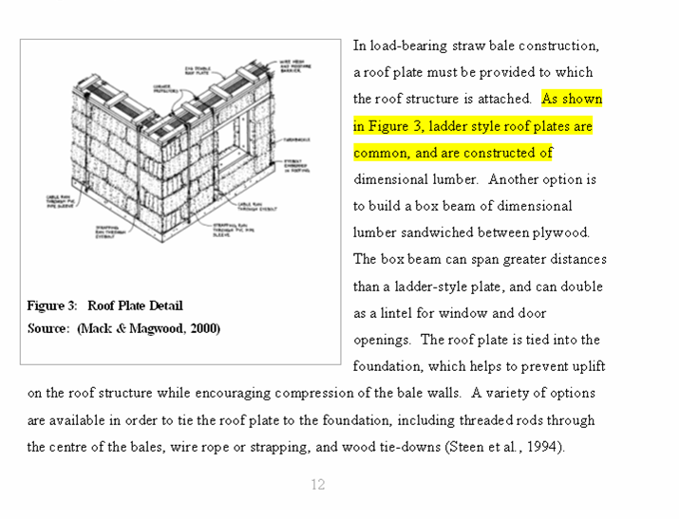
Discuss all Visuals in text
Refer reader to the visual by number
place visual as soon as possible after the reference

Slide 9
TABLES
Portray detailed statistical and other information for comparison horizontally
Consist of horizontal rows and vertical columns
Leftmost column holds the row headings and is called the STUB (not used in all tables)
Top row holds the column headings and is called the BOXHEAD; specify unit measurements in box head rather than in each cell. Centre and bold the box head text. All tables must include a box head row.
Align columns according to the material in the cells: left align text, right align numbers, left align combinations
Explain key points of the table; refer to tables in nearby text, and explain the significance. Data does not “speak for itself” – you must discuss its significance.

Slide 10
SAMPLE

Slide 11
Sample Table
Design A |  | Design B
Materials | Cost | Materials | Costs
TOTAL COST
Note: Type in box head is usually centered and bolded to distinguish it
from the data in the table and enhance readability.
Always give the totals; don’t’ make your reader do math.

Slide 12
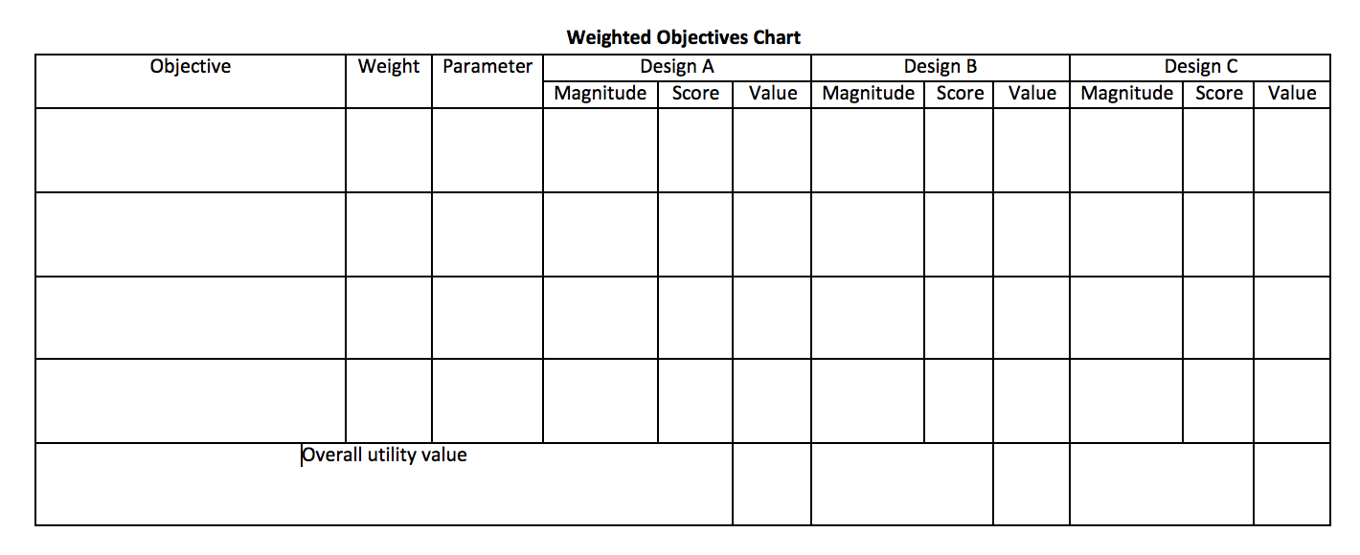
Weighted Objectives Table
Notes:
This can be considered either a table or a figure (chart), since the information in the cells can be both numerical and textual. You can therefore caption a Weighted Objectives Chart as either a figure or a table.

Slide 13
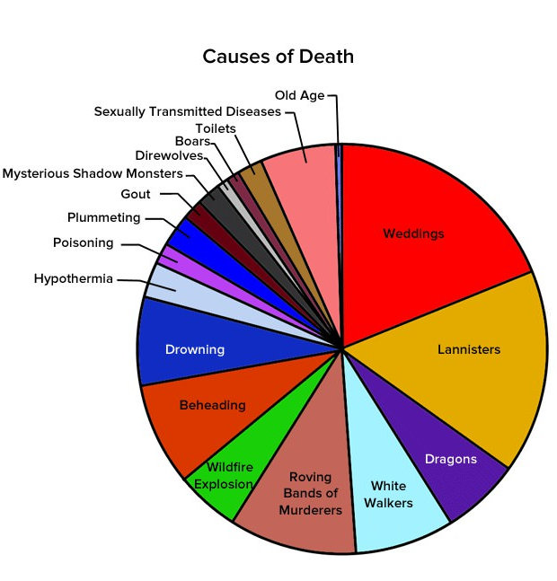
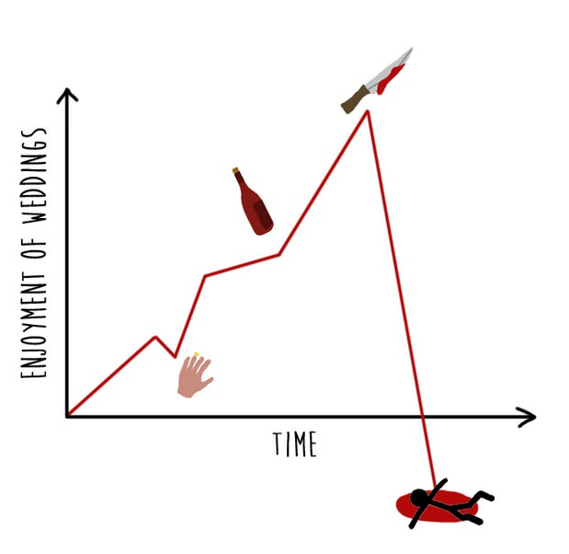


TYPES OF FIGURES
Graphs
Line graphs
Bar graphs
Charts
Flow charts
Pie Charts
Organizational charts (Gantt charts)
Illustrations
Photographs
Diagrams
Drawings

Slide 14
GRAPHS
Line Graphs and Bar Graphs
Display statistical trends, changes, and comparisons
Line Graphs
Portray change over time
Plot points along horizontal and vertical axes
Join points by means of straight line
Horizontal axis identifies the categories of information
Vertical axis identifies incremental values that are being compared
Additional lines can be added for comparison

Slide 15
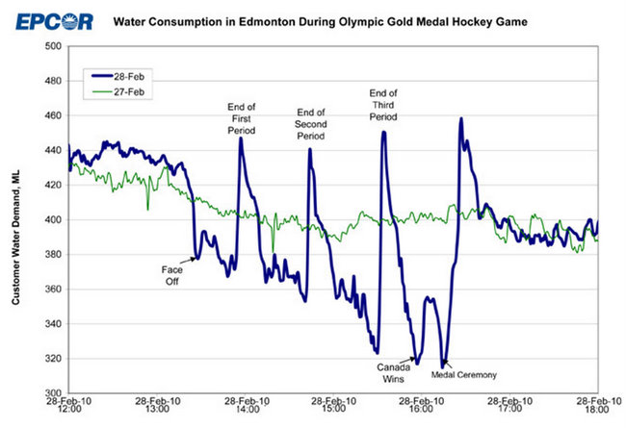
Sample Line Graph
Caption
Legend
Captions
for key
data
Points
X axis
Y axis

Slide 16
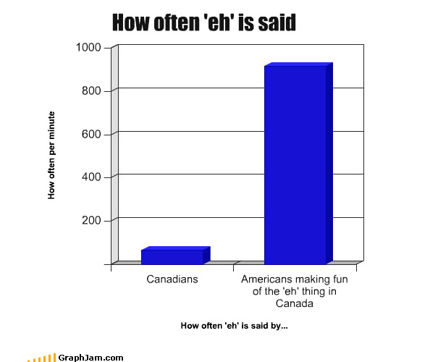
Sample Bar Graph
Figure 1. Comparison of how often Americans vs Canadians say “eh”

Slide 17
Bar Graphs
Consist of horizontal and vertical axes that depict dependent and independent variables
Which axis depicts which variable is determined by whether bars are horizontal or vertical
Horizontal bar graphs are useful for accommodating many bars and have room for labels if titles are lengthy

Slide 18
CHARTS
Portray quantitative, cause-and-effect, and other relationships among parts of a unified whole
Can depict
Steps in a production process
Chain of command in an organization
Sequential or hierarchical interactions

Slide 19

Flow Charts
Used to portray the steps through which work must flow
Read from top to bottom or from left to right

Slide 20
Organizational Charts
Portray chains of command within organizations
Most powerful positions placed at the top
Least powerful positions placed at the bottom
Portray relationships between elements (can be non-hierarchical)
Gantt Charts – project management tool showing when all tasks are to be done in a project over a period of time

Slide 21
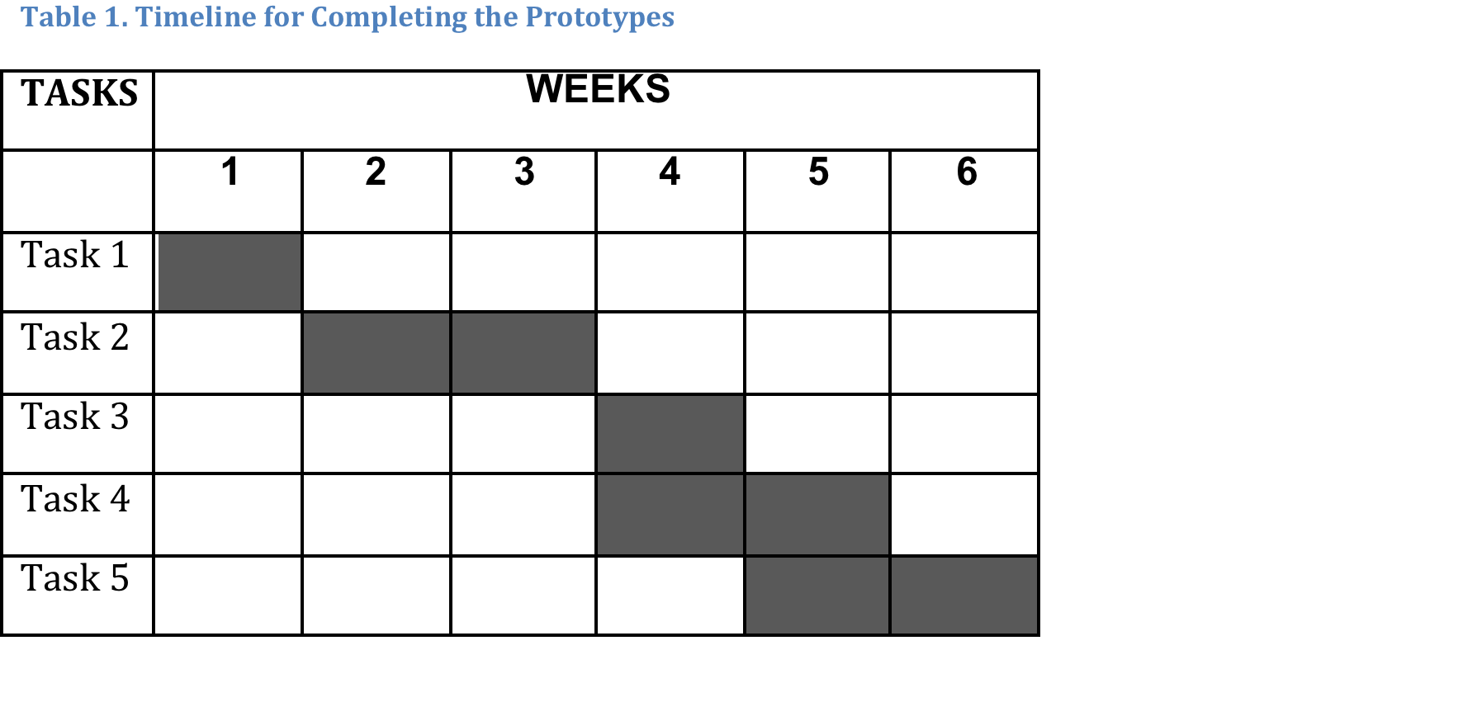
Sample Gantt Chart

Slide 22
Pie Chart
Pie Or Circle Charts – depict relationships among parts within statistical wholes
Often used to show the percentage distribution of budget or resources
Should have at least 3, but ideally no more than 7, segments resembling slices of pie and constituting a percentage
Each slice labeled, showing percentage of the total

Slide 23


Non-Optimal Pie Chart
Figure 4: Causes of death in Game of Thrones
Figure 3: uses of semicolons

Slide 24
ILLUSTRATIONS
Illustrations such as photographs and diagrams help the reader to understand what you explain in your text. Some documents that NEED illustrations include
Instructions
Need to show the components of the objects involved, and the orientations between the objects and the tools
Technical background reports
Need to use diagrams and drawings, photographic evidence, conceptual drawings with maps, etc.

Slide 25

Photographs
Exact representations; strictly accurate
Provide overall-view
Required in certain types of documents
Try to make photo as clear and high quality as possible
Figure 5. Shimano Road Bike Drive Train
Photos can contain too much detail that is unnecessary and simply create clutter or confusion.

Slide 26
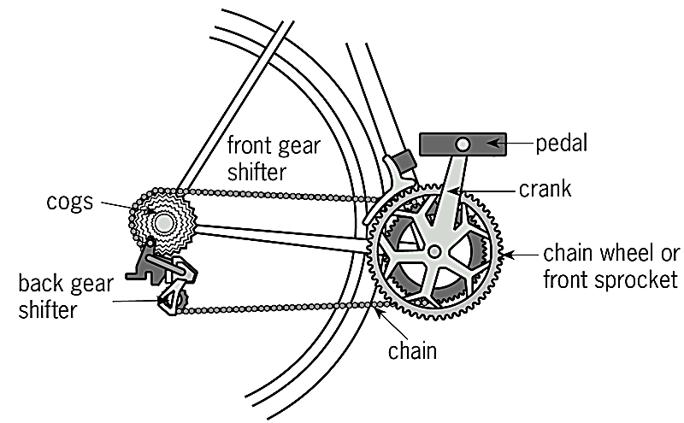
Diagrams
Simplified, realistic depictions of objects or specific aspects/details
Portrays what is most relevant and clarifies information; focuses on important features
Figure 6. Bicycle drive train

Slide 27
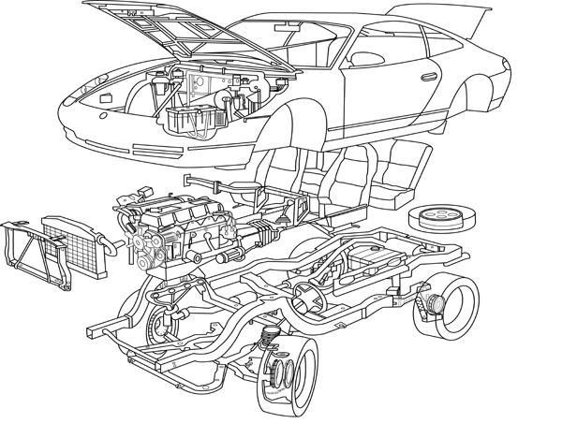

Kinds of Diagrams
Figure 7. Conventional line drawing
Figure 8. Exploded View

Slide 28


Kinds of Diagrams-- Contd..
Figure 9. Cut-away diagram
Figure 10. Clip art

Slide 29

Contd..
Figure 11. Venn diagram

Slide 30
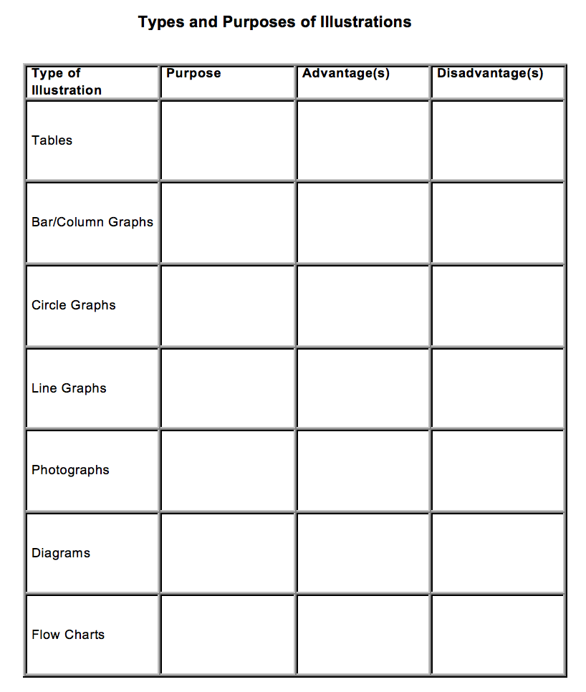
Consider pros and cons: Use the right visual for your purpose and audience.

